Slide 1






eNGLISH YEAR 2
MODULE 5
FREE TIME

Slide 2

Learning Objectives
By the end of the lesson, pupils will be able to:
1. Ask for and give basic personal information using basic questions and statements.
2. Introduce self to an audience using fixed phrases.

Slide 3



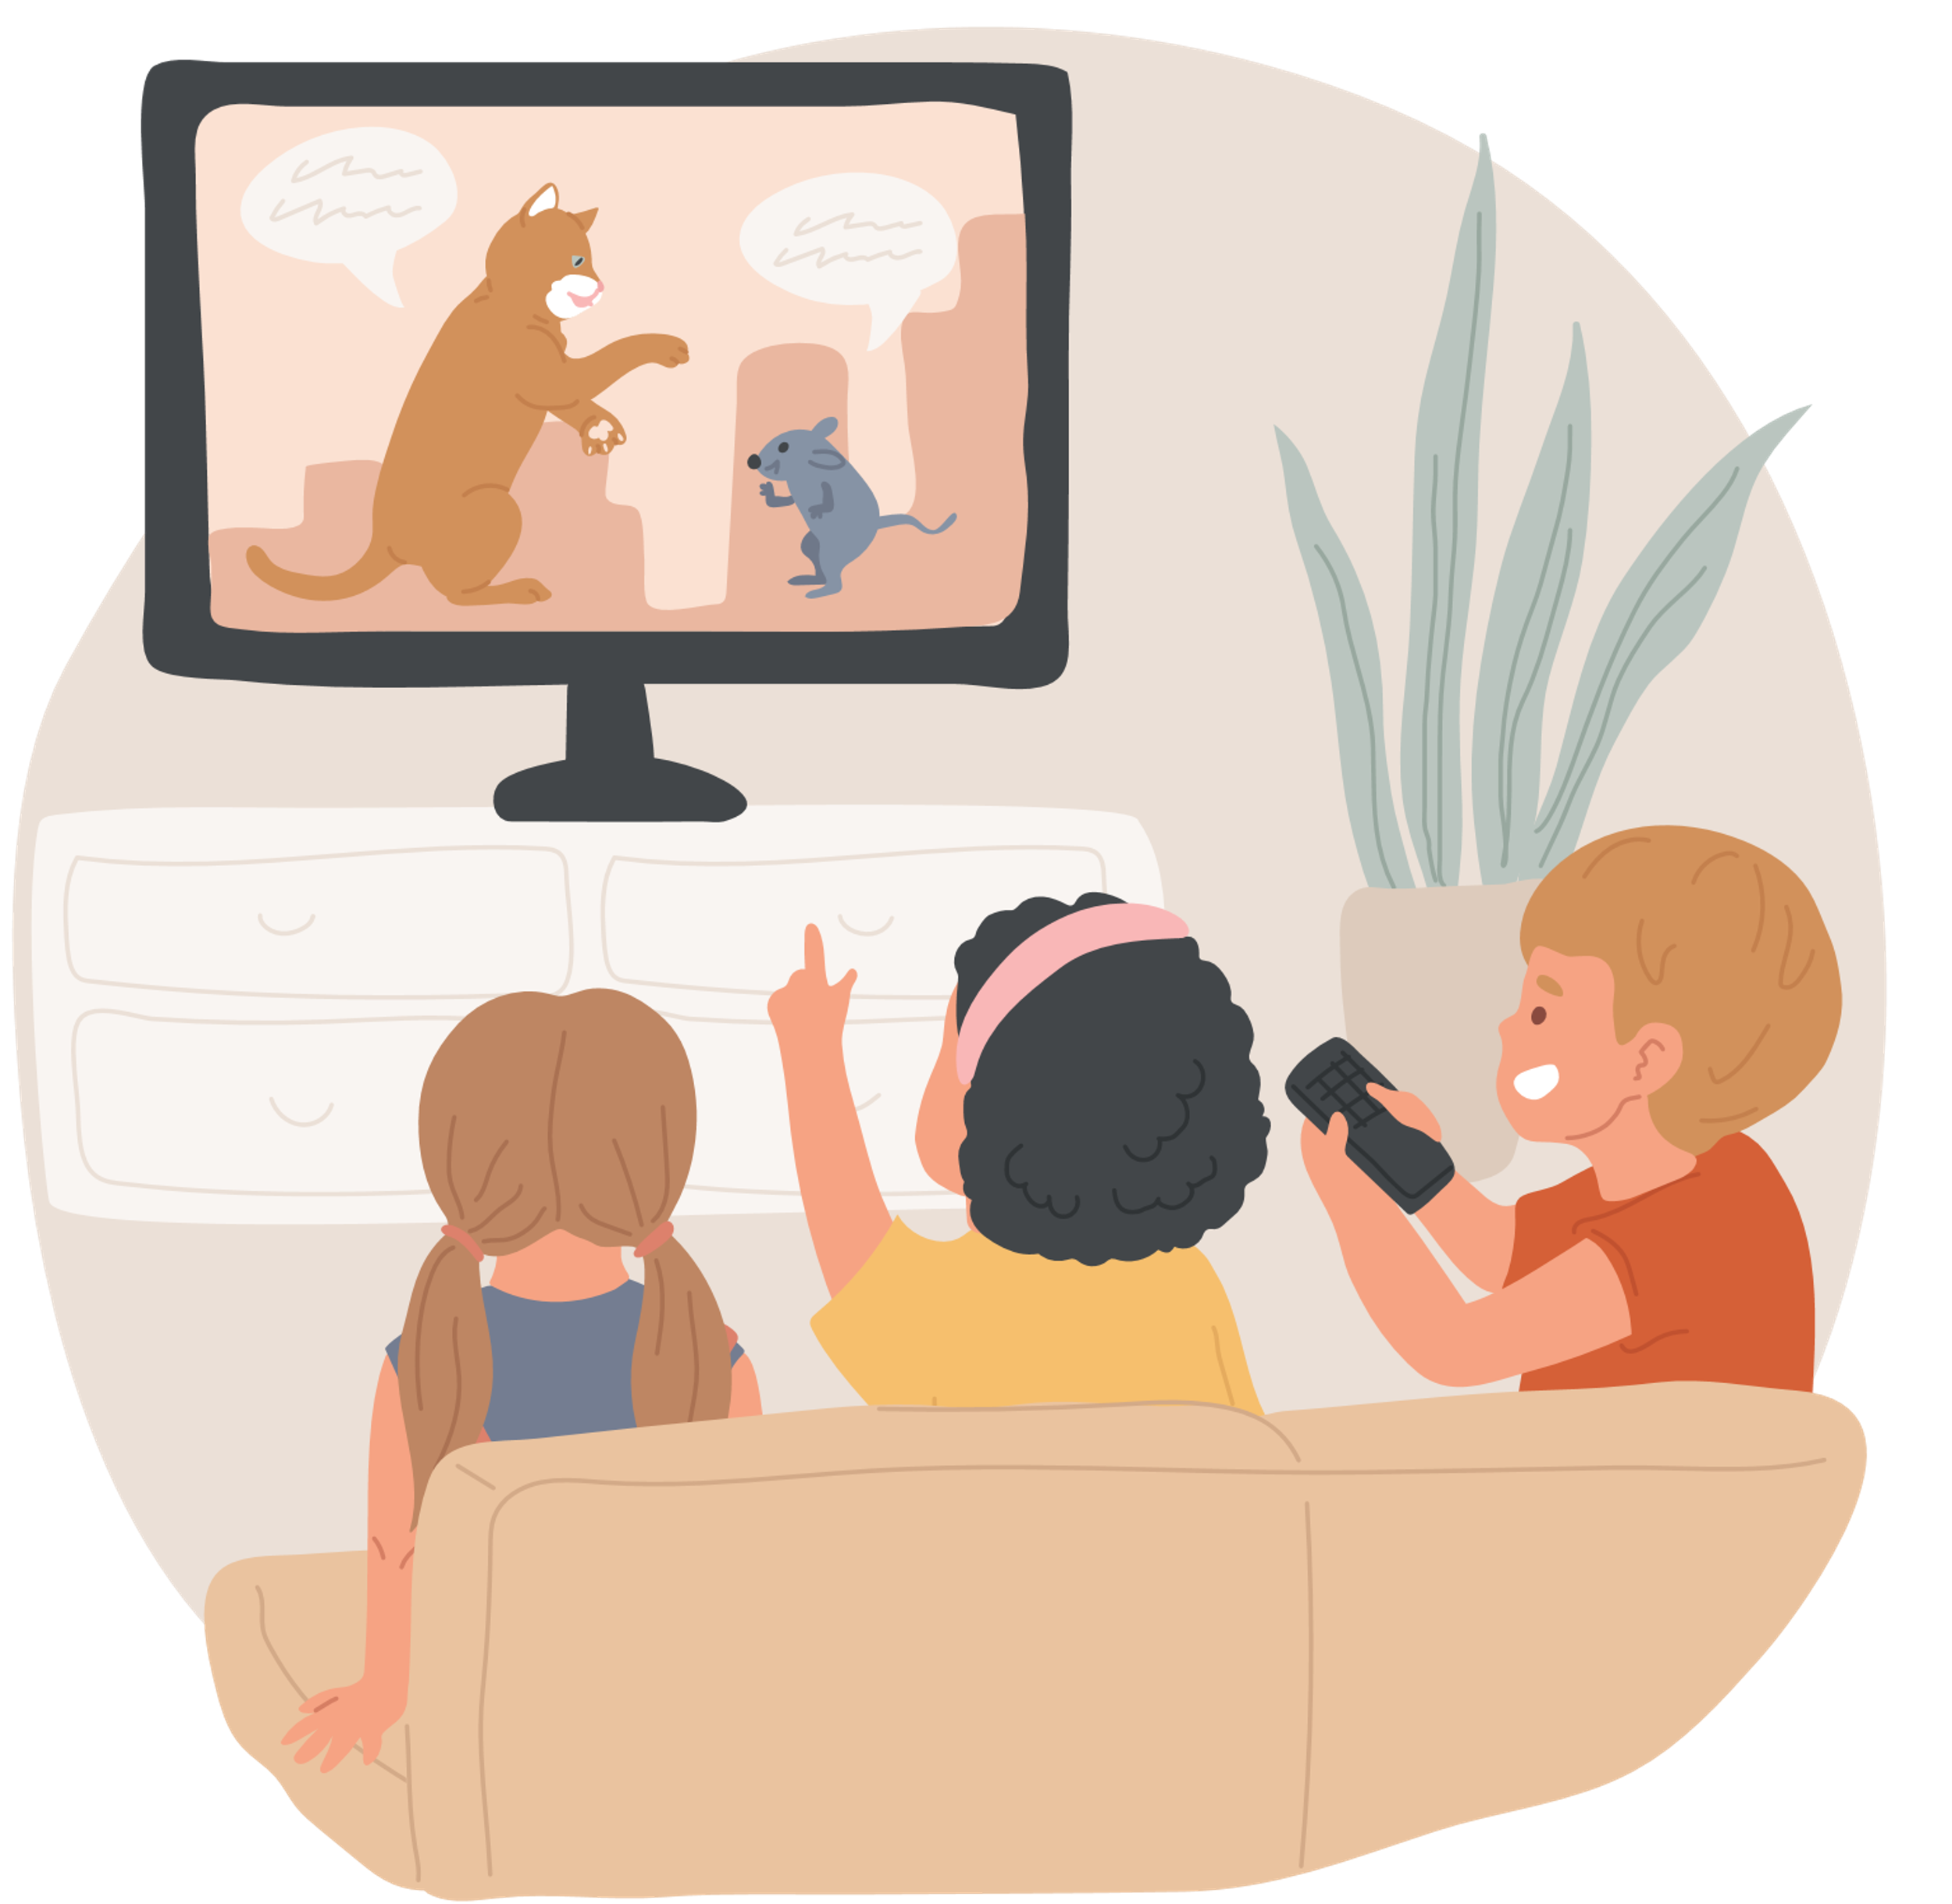

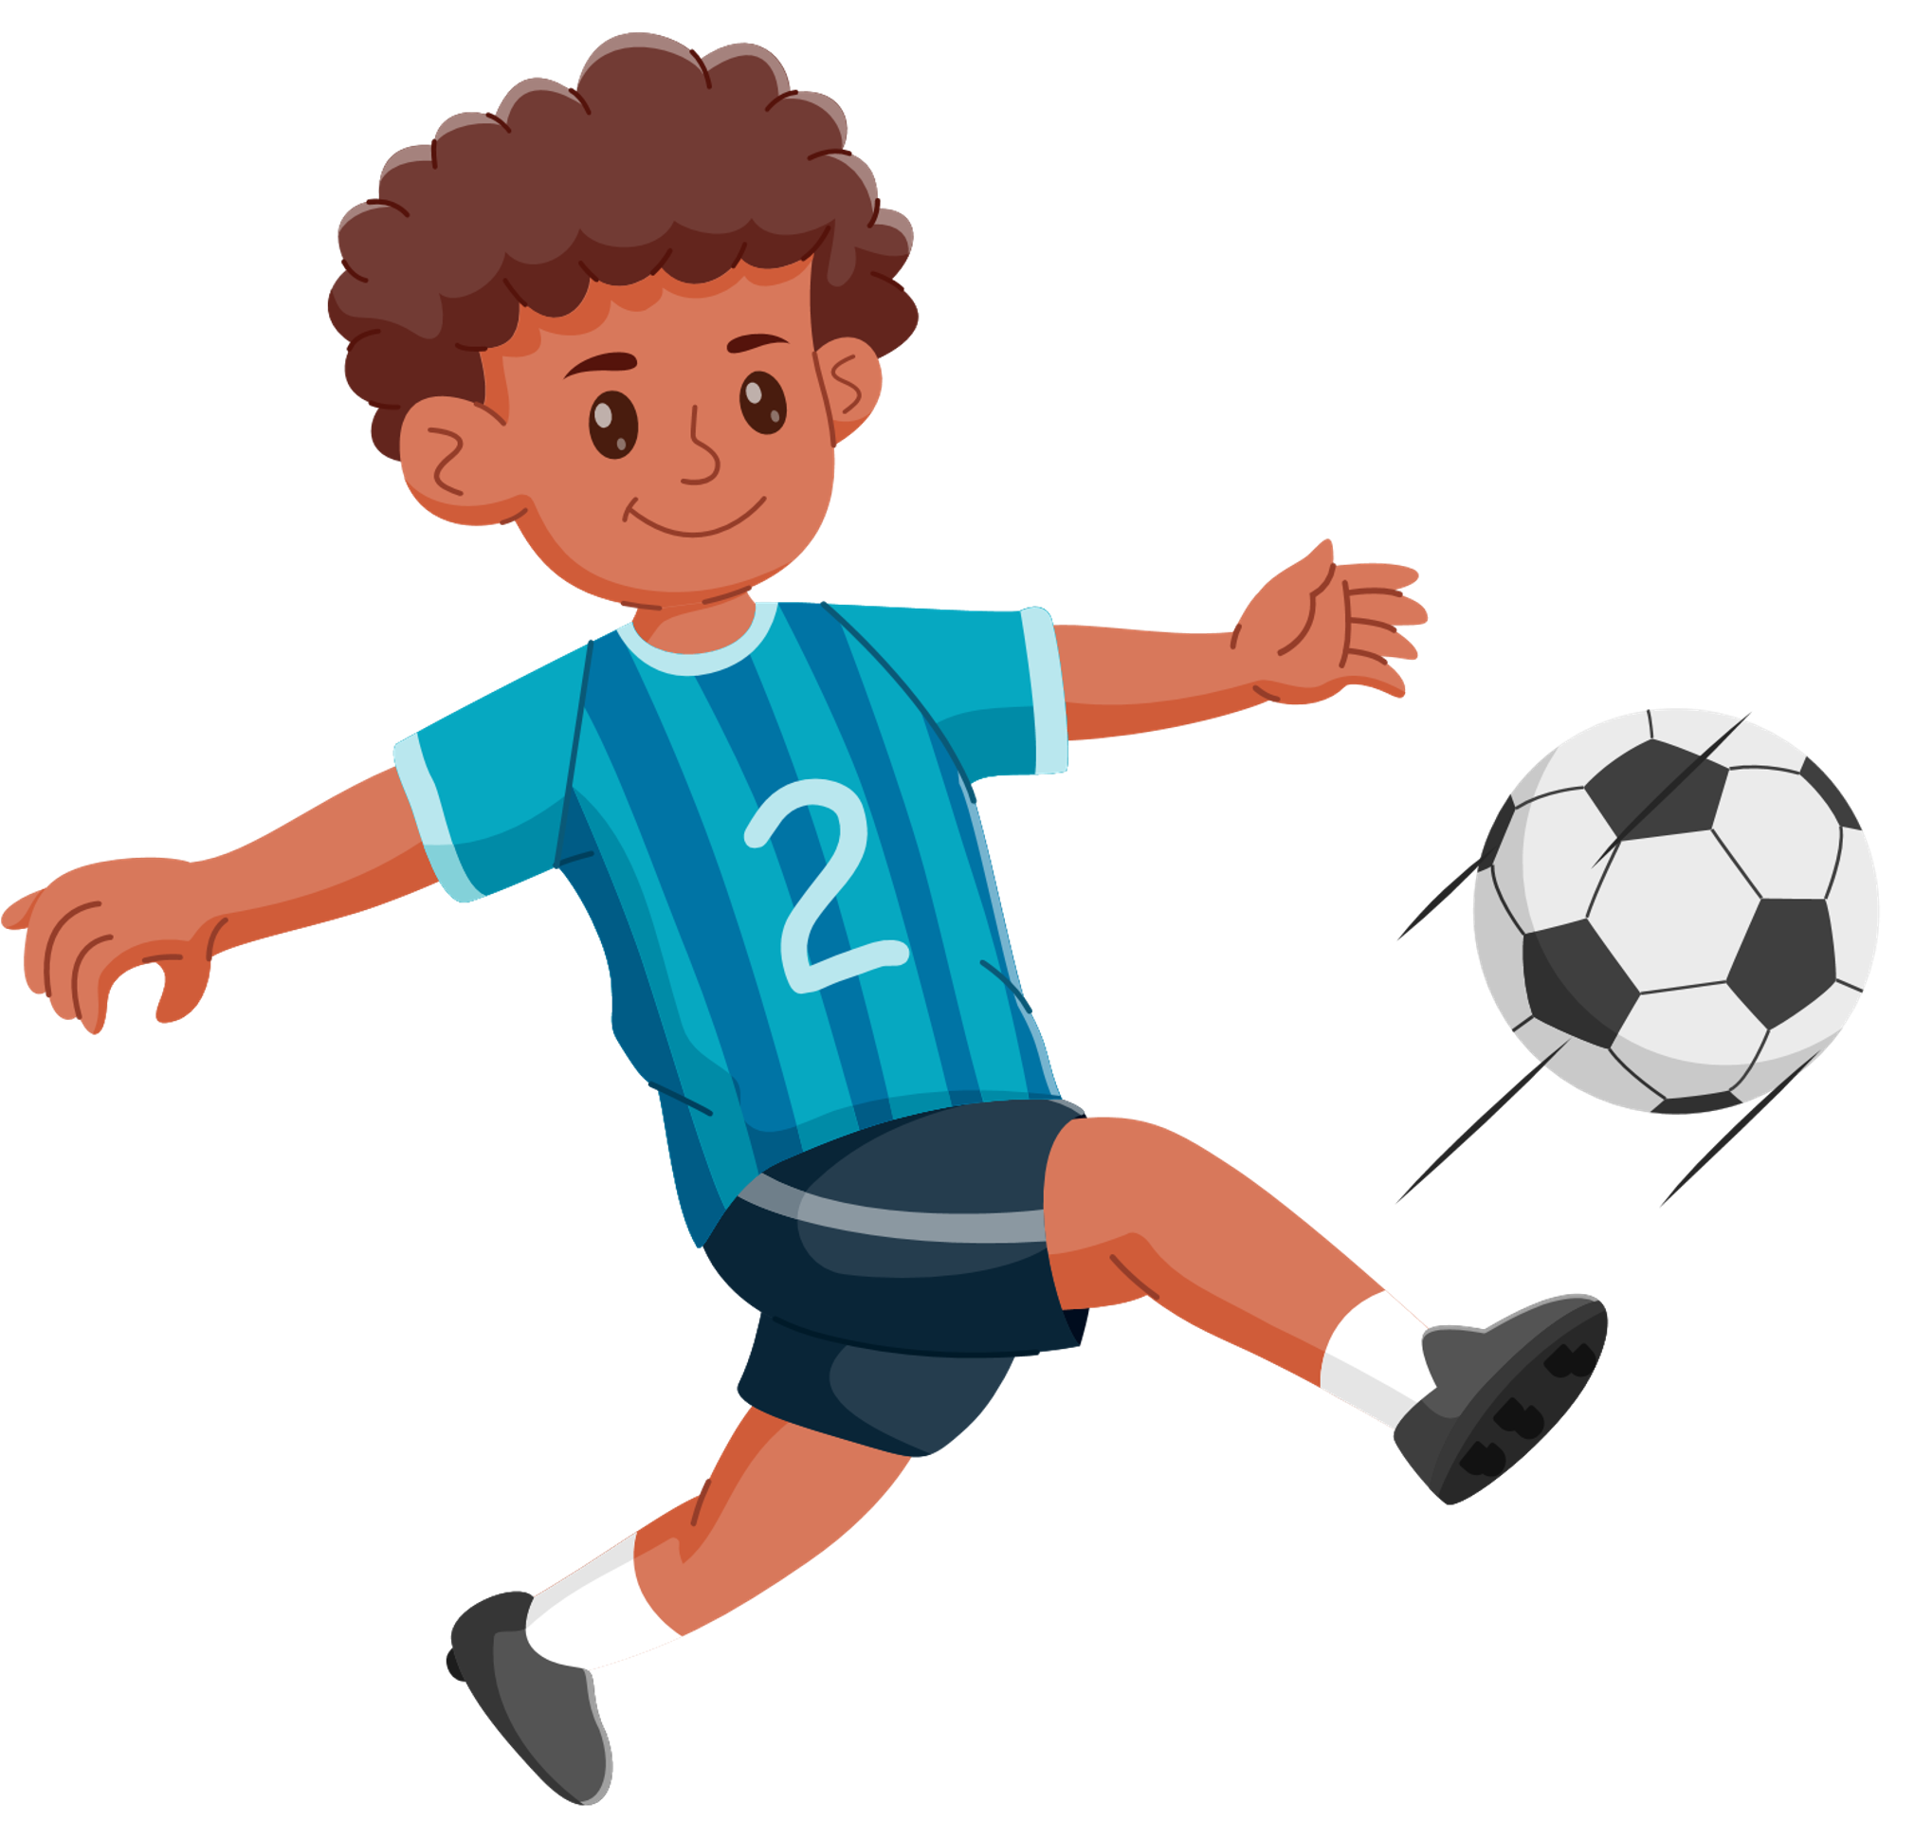
What can you do during your free time?
I can go swimming on Monday.
I can play with my sibling on Saturday .
I can do revision on Tuesday.
I can watch a movie every Thursday.
I can go to then beach every Sunday.
I can play football every evening.

Slide 4

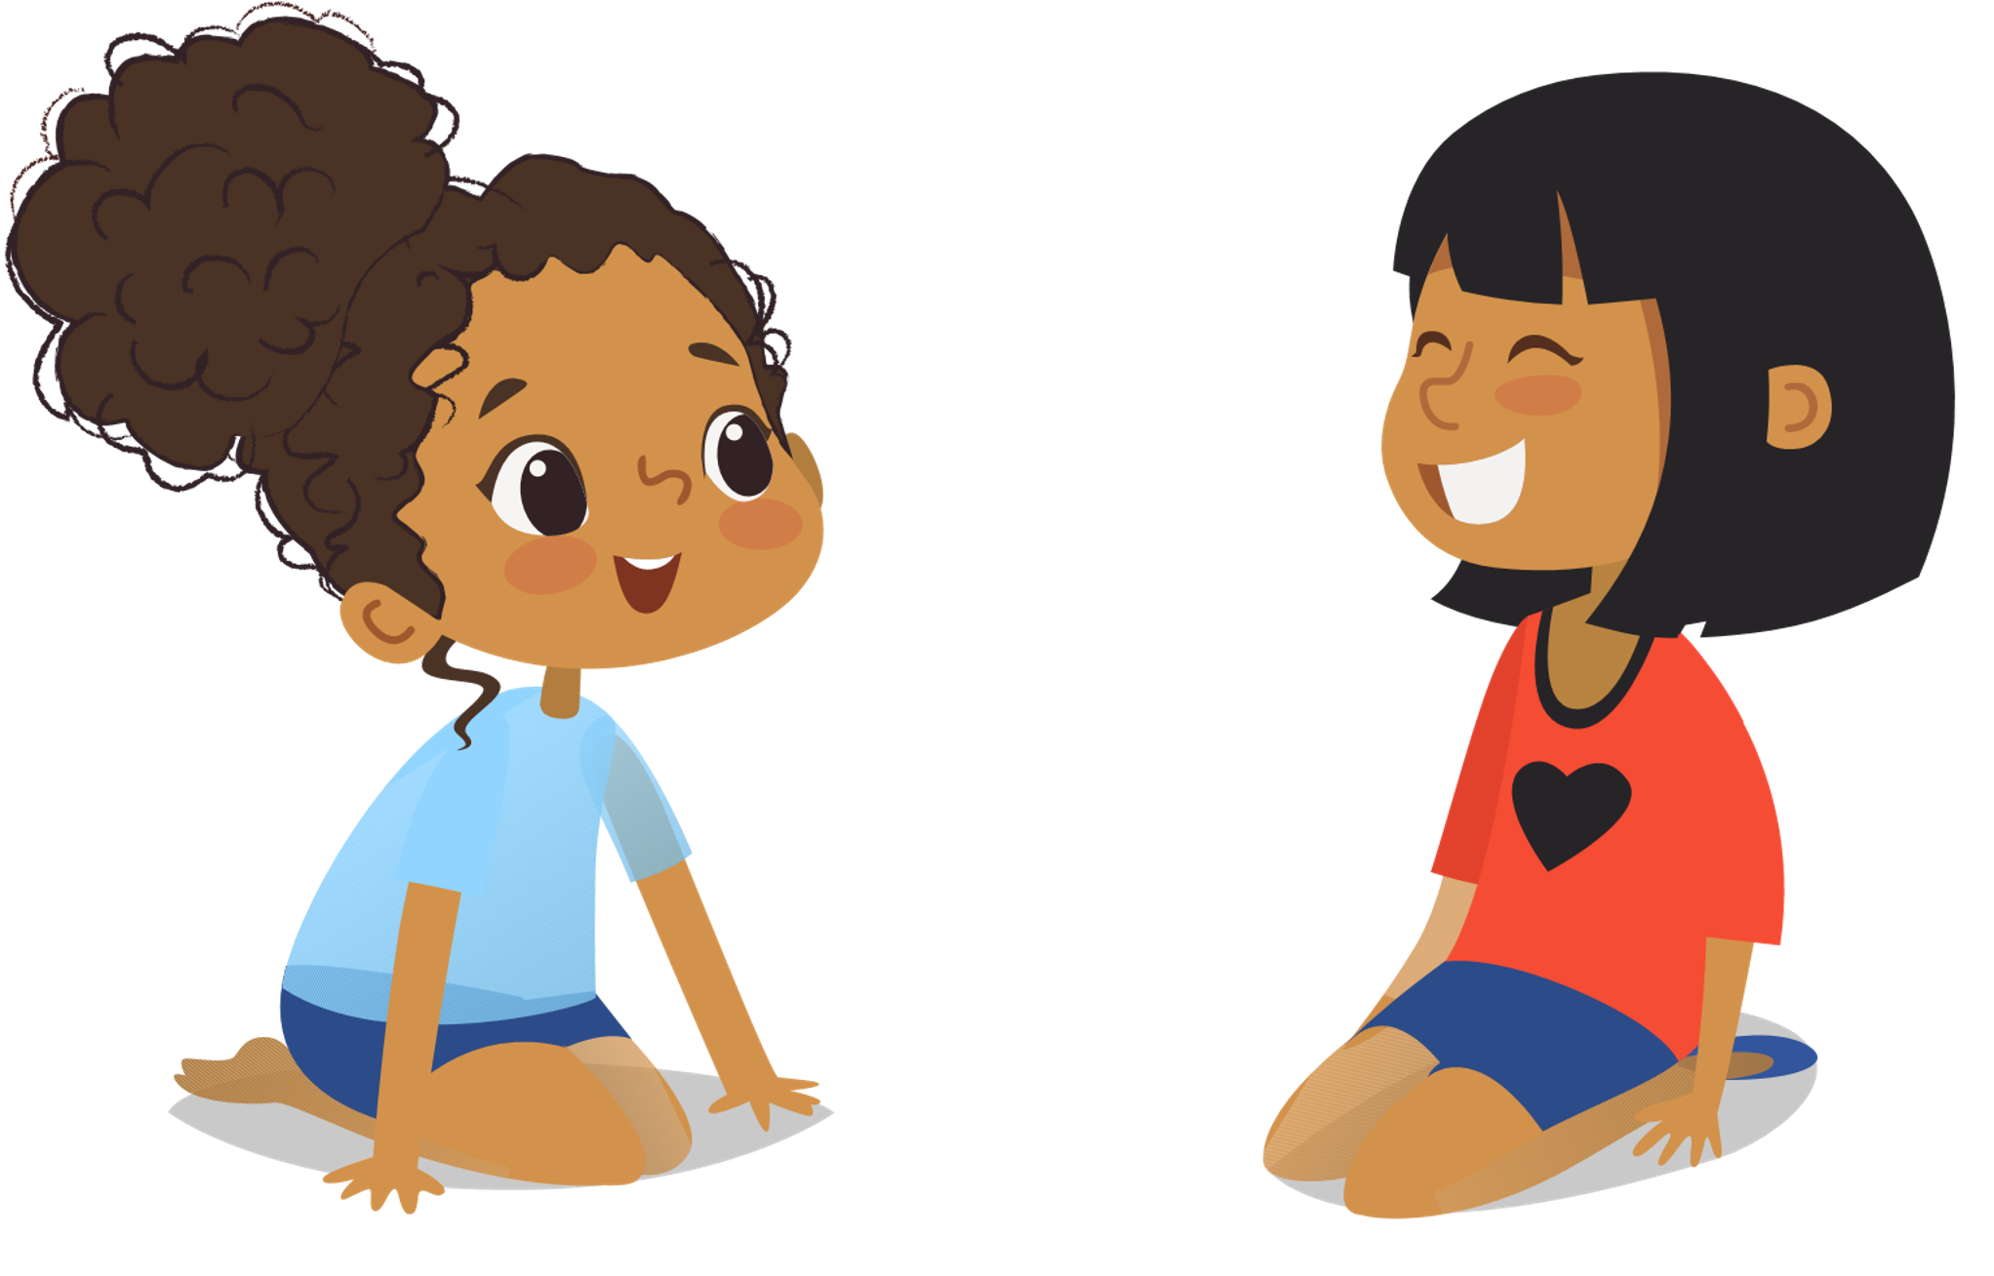
ACTIVITY TIME!
Form a group of five.
Ask your friends what they do during their free time.

Slide 5
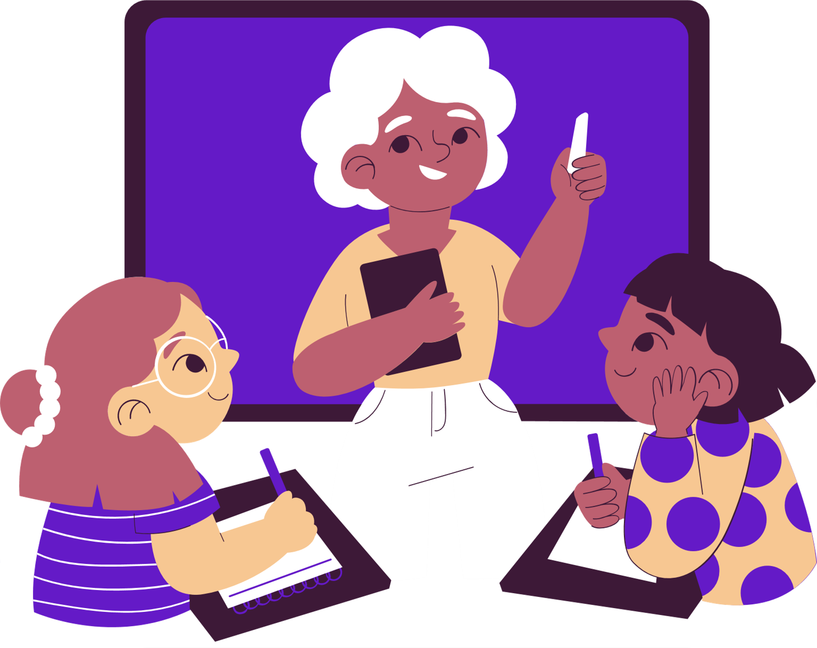
What did we learn today?

Slide 6


